Slide 1
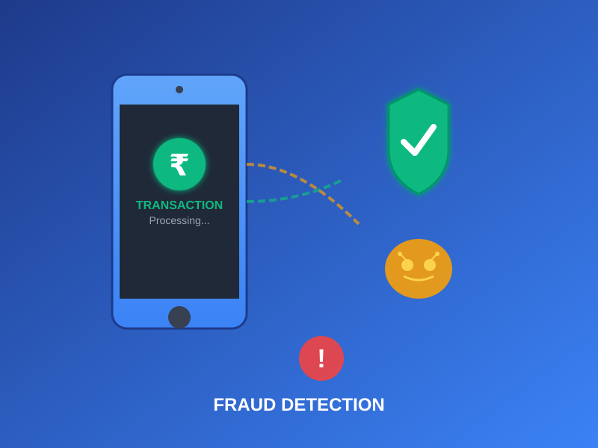
PROJECT
UPI Fraud Detection
Using Machine Learning and Deep Learning

Slide 2
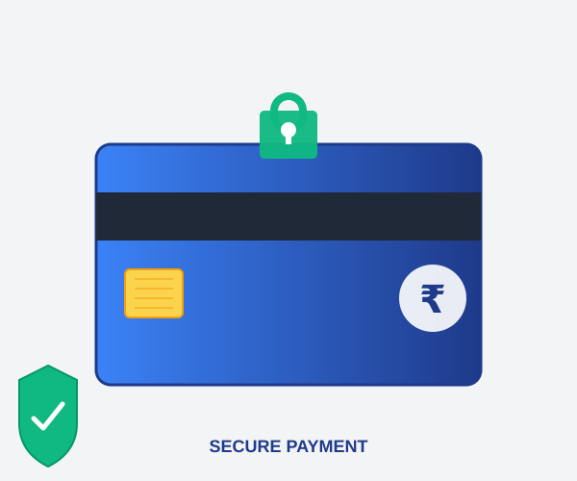
Introduction
Digital Payment Revolution in India
The Unified Payments Interface (UPI) has transformed financial transactions in India, democratizing financial inclusion through seamless, instant fund transfers.
The Challenge
Fraudulent transactions have become a growing problem
Fraudsters continuously adapt to detection systems
Manual review of large transaction volumes is impossible
Early detection is crucial to prevent further fraud

Slide 3


The Problem & Solution
PROBLEM
SOLUTION
Large volume of transactions
Evolving fraud patterns
Manual detection ineffective
Security vulnerabilities
Need for real-time detection
Machine Learning algorithms
Deep Learning techniques
Automated pattern recognition
Real-time fraud detection
Adaptive to new threats

Slide 4

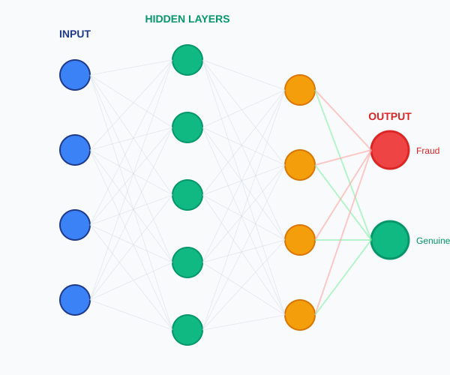



Research Objectives
Data Collection & Preprocessing
Gather and pre-process diverse UPI transaction datasets for effective fraud detection
Feature Engineering
Identify pertinent features and create new metrics to enhance model discrimination
Algorithm Selection & Training
Select and train ML/DL algorithms for effective fraud detection
System Integration
Integrate trained model into UPI system for real-time processing with alert mechanisms
Continuous Improvement
Establish monitoring, updates, and explore ensemble methods for model robustness

Slide 5
Methodology: Supervised Learning
1. Model Construction
Define model architecture based on ML/DL algorithm. Save learned rules and data structures for predictions.
2. Model Training
Train model using training data with labeled inputs and outputs. Report final accuracy metrics.
3. Model Testing
Validate with unseen test data to verify true accuracy and generalization capability.
4. Model Evaluation
Use Hold-Out and Cross-Validation methods to assess performance and avoid overfitting.

Slide 6




System Architecture
Dataset
(Labeled: Real/Fraud)
Input
Preprocessing
Feature
Selection
Model
Training
Evaluation
(Metrics)
Best Model
Selection
Prediction
Engine
Real-time
Detection
ML Algorithms: Random Forest, XGBoost, Light GBM, Decision Tree, Logistic Regression
DL Algorithms: CNN, RNN, LSTM, Neural Networks

Slide 7
Machine Learning & Deep Learning Algorithms
Machine Learning
Deep Learning
Random Forest
Neural Networks
Ensemble method using multiple decision trees
Multi-layer perceptron for complex patterns
XGBoost
CNN
Gradient boosting optimized for performance
Convolutional networks for pattern recognition
Light GBM
RNN
Histogram-based gradient boosting
Recurrent networks for sequential data
Decision Tree
LSTM
Tree-based interpretable classification
Long Short-Term Memory for time-series
Logistic Regression
Statistical binary classification method

Slide 8






Key Features for Fraud Detection
Transaction Amount
Timestamp
Payer & Payee Data
Unusual transaction values and patterns
Time-based features weighted heavily for analysis
User identification and behavioral patterns
Location
Device Information
Transaction Frequency
Geographic anomalies and location-based risks
Device fingerprinting and anomaly detection
Velocity checks and pattern analysis

Slide 9

Future Scope & Enhancements
Advanced Techniques
Advanced deep learning architectures (Transformers, GANs)
Behavioral biometrics for user profiling
Real-time adaptive learning systems
Technology Integration
Quantum computing compatibility
Explainable AI (XAI) for transparency
Blockchain integration for secure auditing
Global Collaboration
Cross-platform fraud detection networks
International data sharing frameworks

Slide 10
Conclusion
UPI fraud detection using ML and DL is crucial for securing digital payments
Key Benefits:
Enhanced accuracy through deep learning
Real-time monitoring and intervention
Adaptability to evolving fraud patterns
Increased user trust and confidence
Reduced financial losses for institutions
The system prioritizes ethical considerations, user privacy, and regulatory compliance while strengthening the overall security of UPI transactions.
Thank You

